Slide 1


CAPY BARA
カピバラ

Slide 2

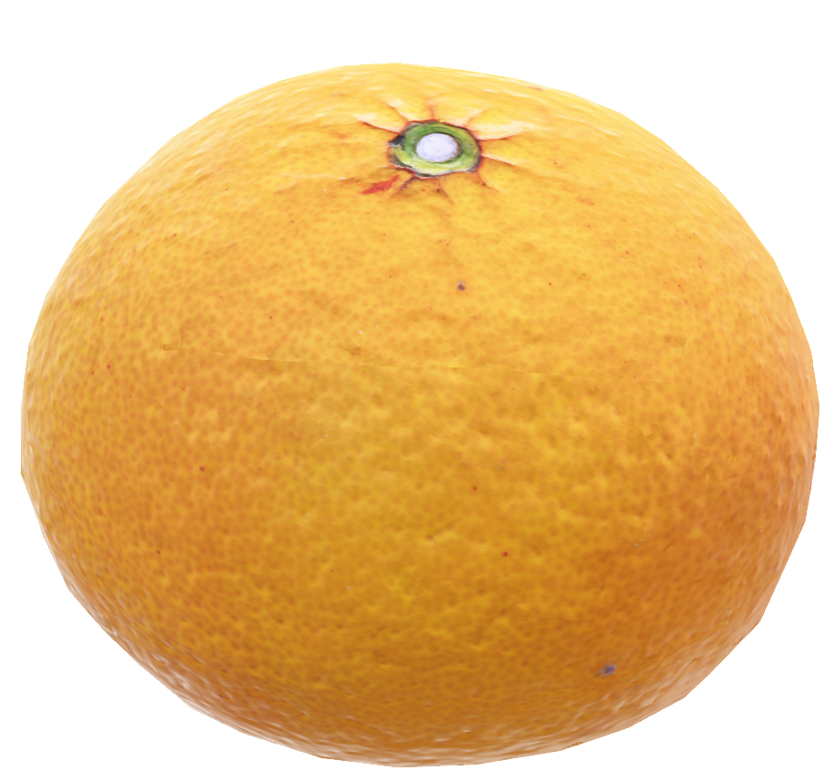
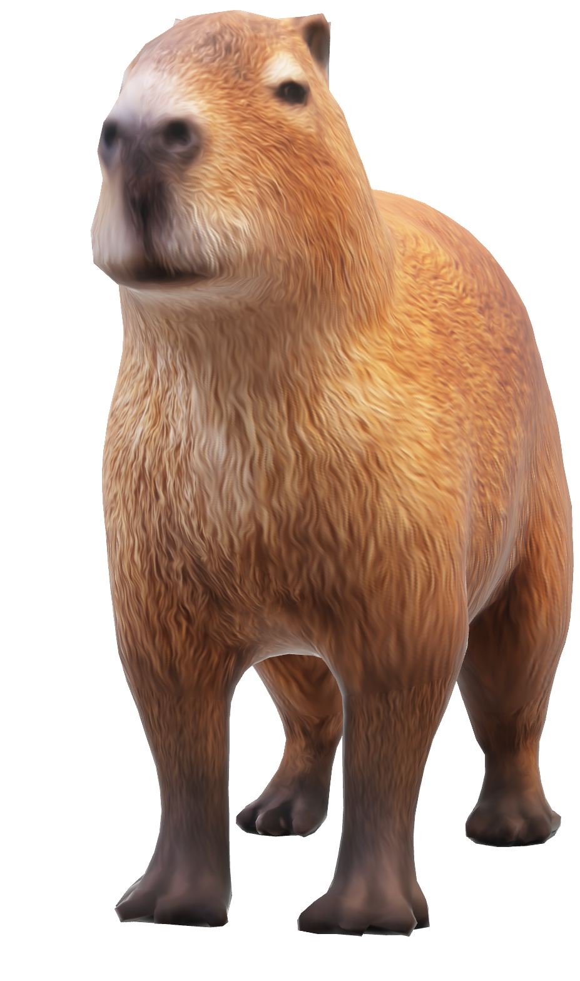
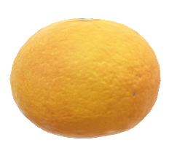
カピバラ
カピバラ
CAPY BARA
ANATOMY
LARGEST RODENT IN THE WORLD

Slide 3


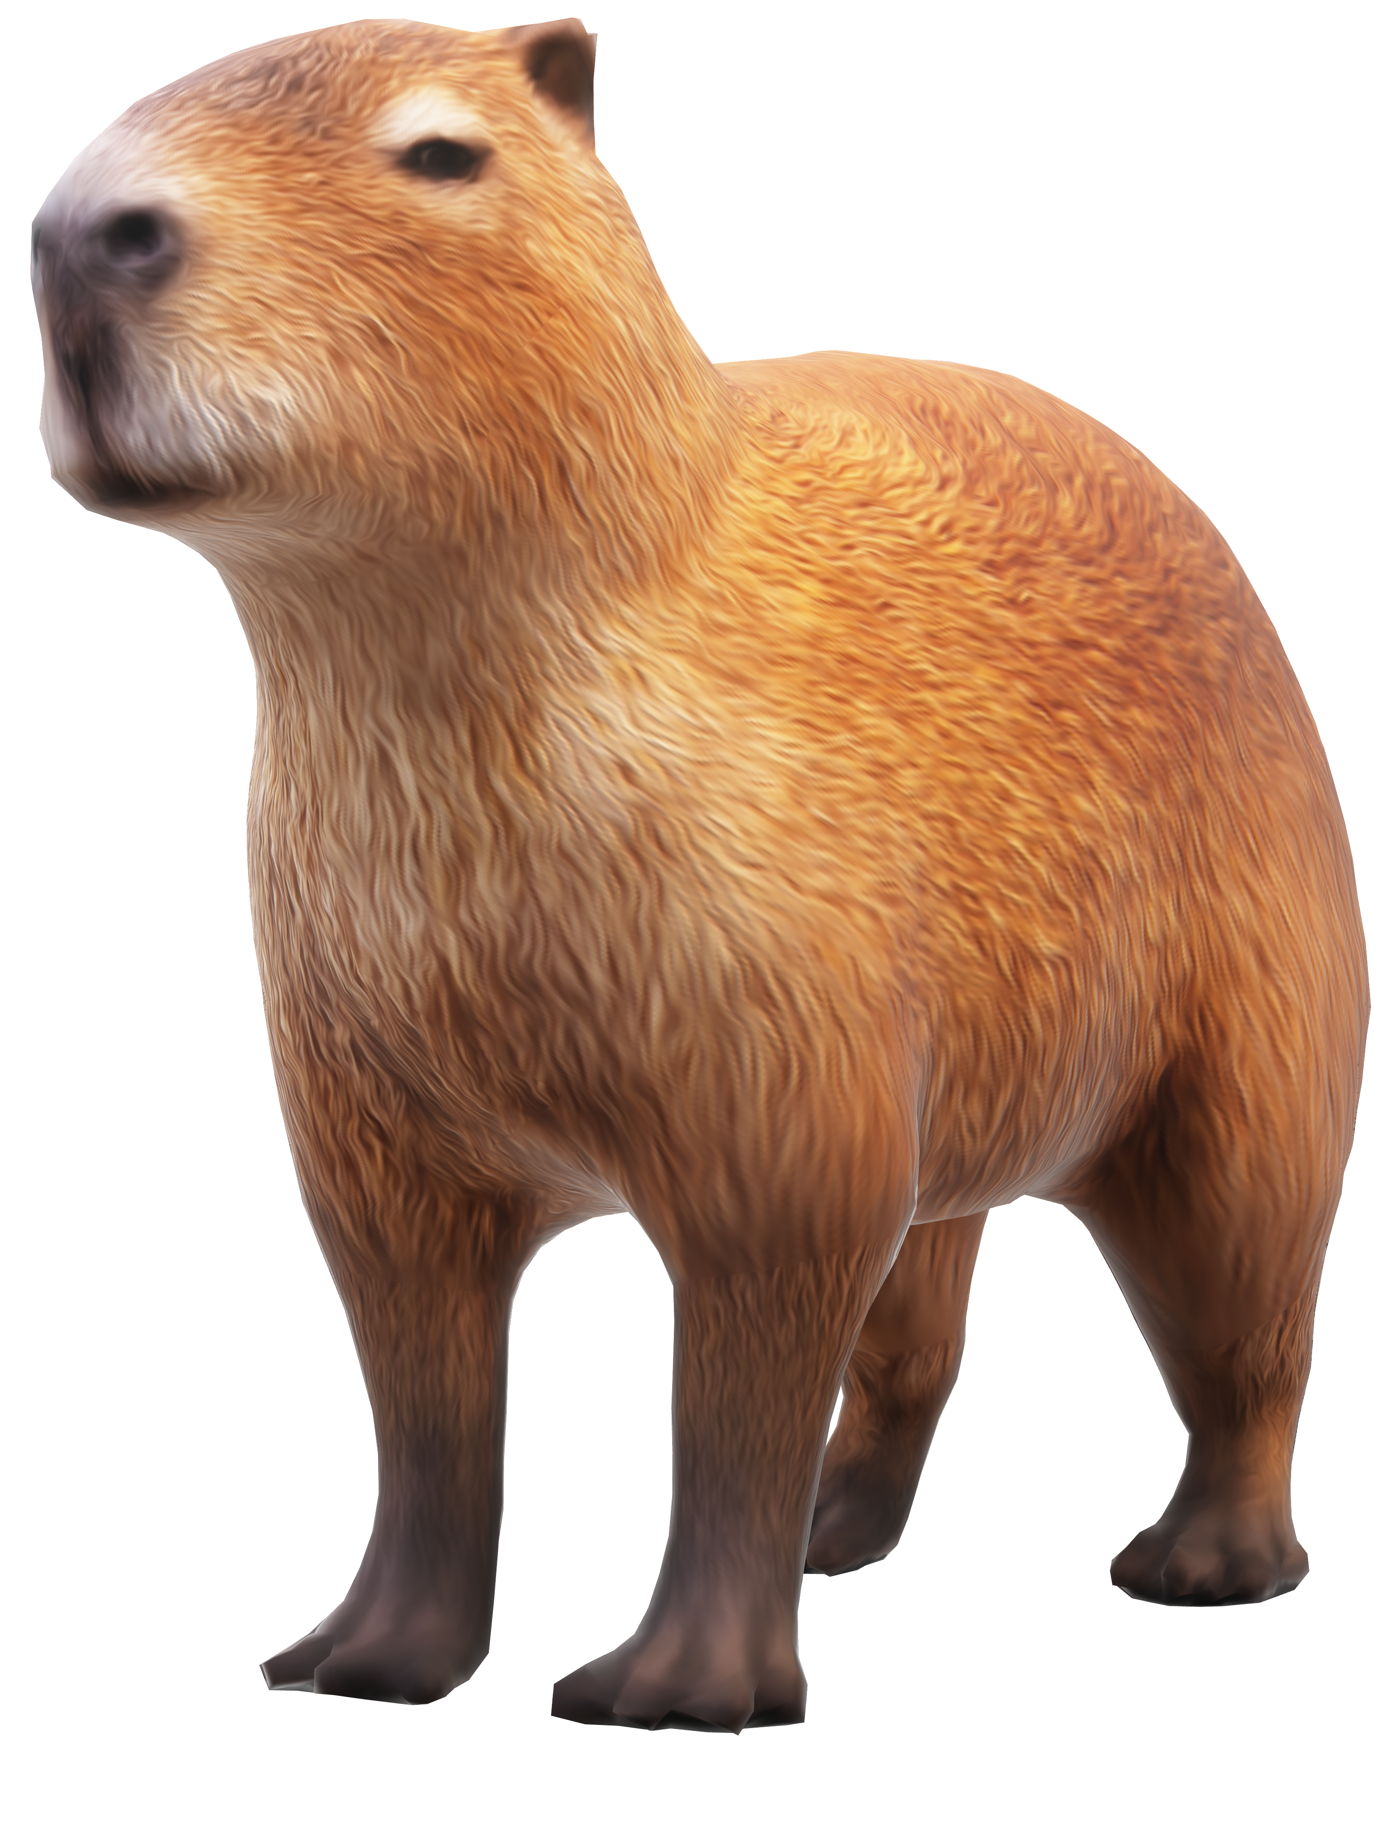

カピバラ
LARGEST RODENT IN THE WORLD
カピバラ
CAPY BARA
WITH SIDE EYES
ANATOMY

Slide 4
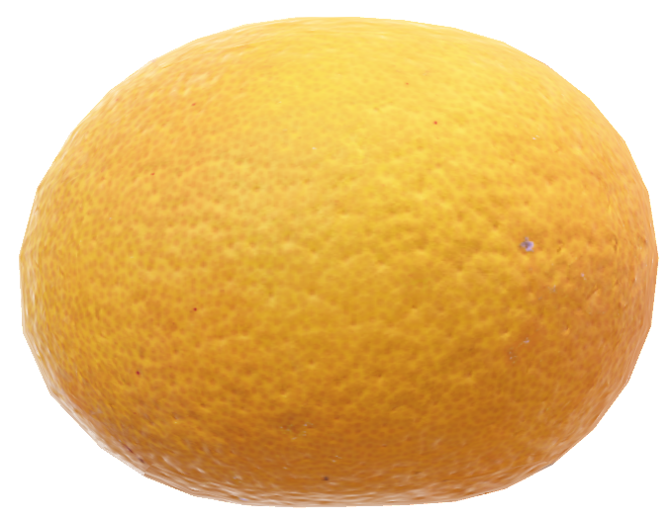



LARGEST RODENT IN THE WORLD
N TAIL.
WITH SIDE EYES

Slide 5
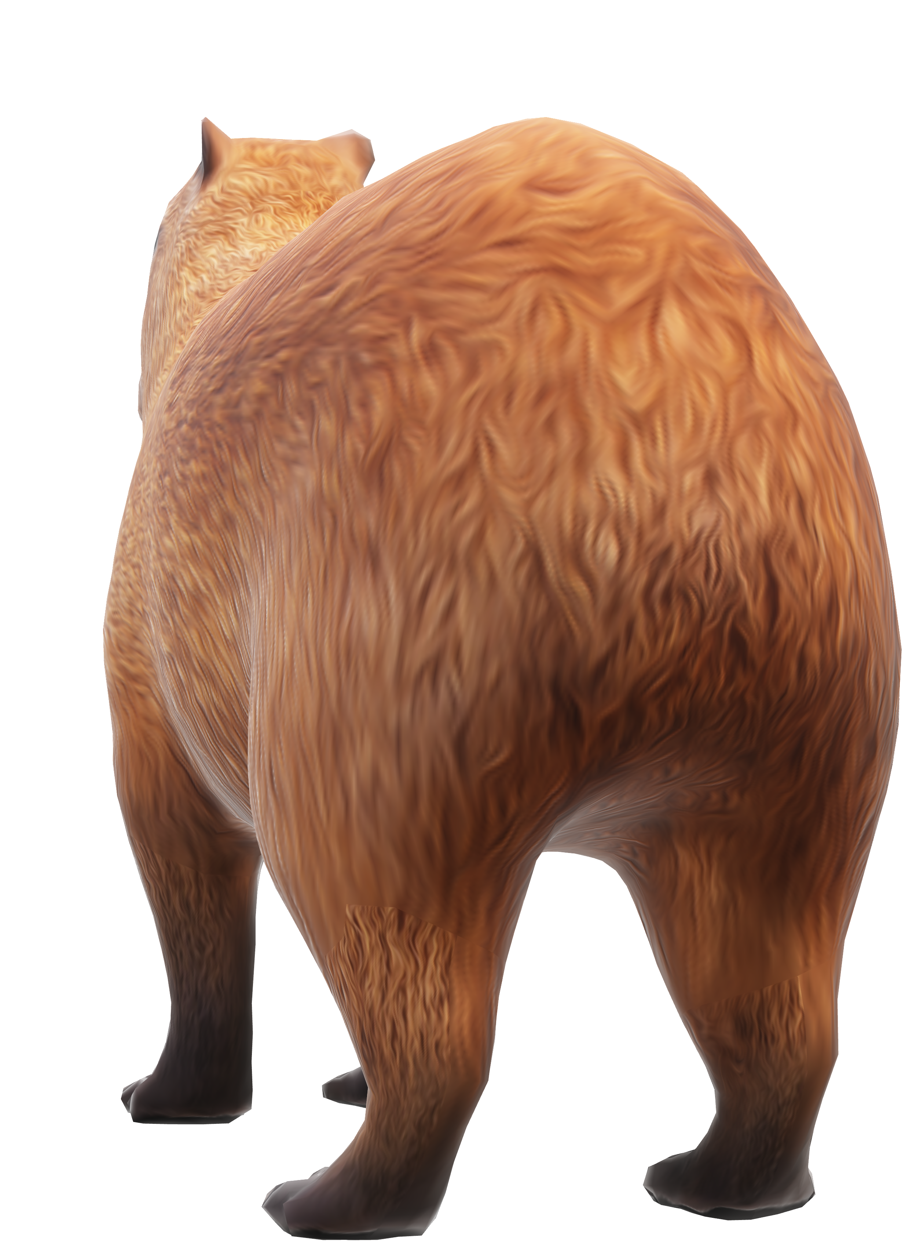



WITH SIDE EYES
N TAIL.
FRONT LEGS SHORTER THAN REAR LEGS

Slide 6
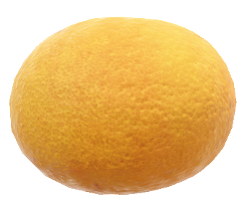

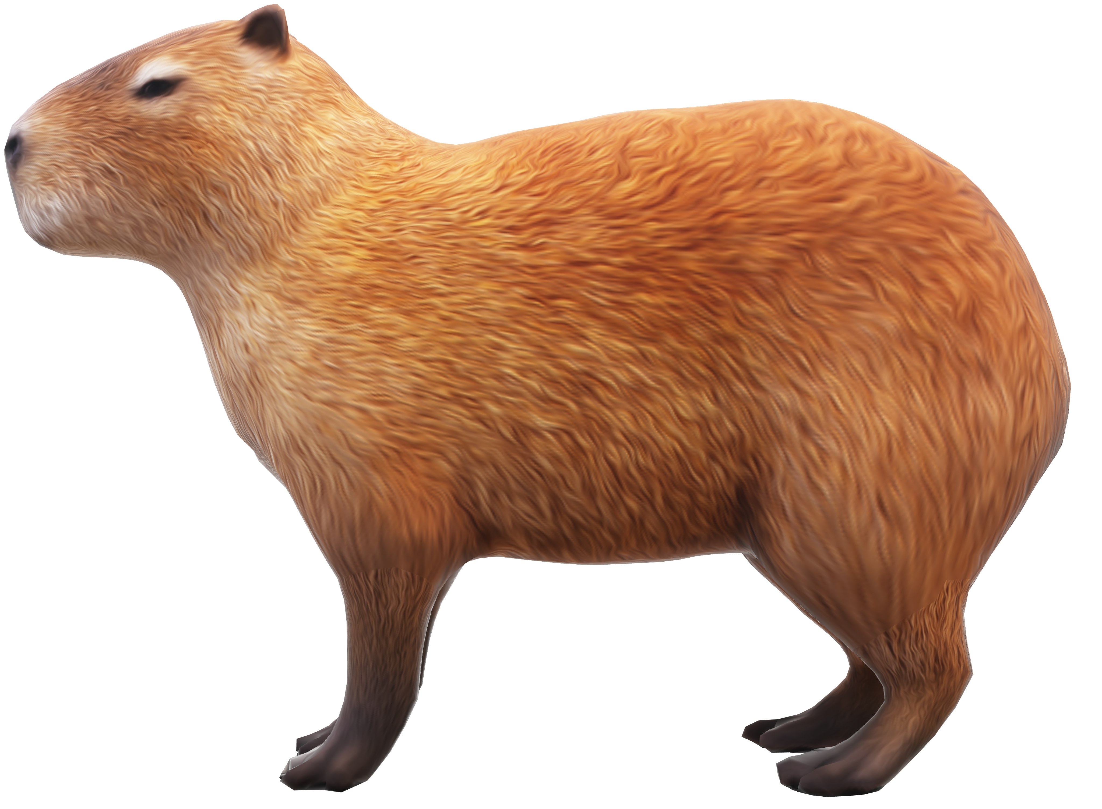
N TAIL.
FRONT LEGS SHORTER THAN REAR LEGS
SLIGHTLY
WEBBED TOES

Slide 7
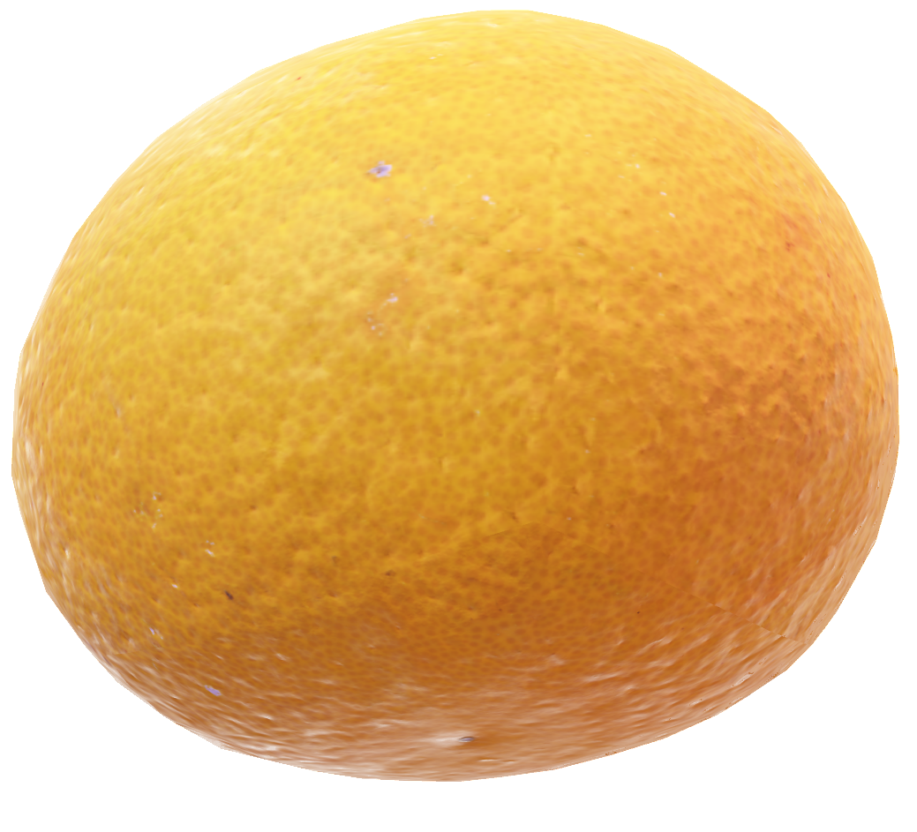


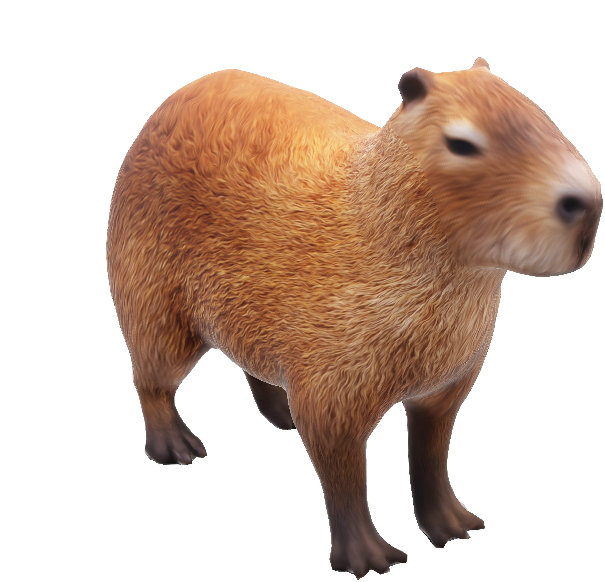
FRONT LEGS SHORTER THAN REAR LEGS
カピバラ
カピバラ
SLIGHTLY
CAPY BARA
WEBBED TOES
ANATOMY

Slide 8
WEBBED TOES
SLIGHTLY
カピバラ
カピバラ
CAPY BARA
ANATOMY

